Slide 1
The Wellness Program
Clean Kiss Oral Care Homecare System

Slide 2
Since 2015
HCP Wellnet joins physicians, dentists, and their patients to make HEALTH contagious with improved Oral Health
Leona Meditz
Founder

Slide 3
Your Secrets to a Clean Kiss

Slide 5
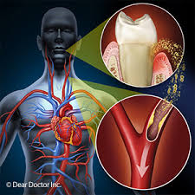
Bacteria in your mouth travels to your body and causes inflammation that can double serious health risks

Slide 6
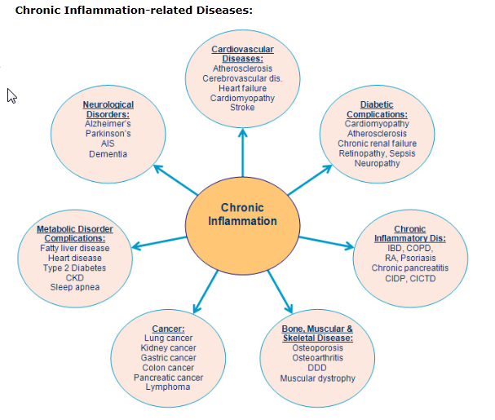
Notes:
Gum disease cause inflammation. Here are some of the diseases caused by inflammation

Slide 7
Clean Kiss System
Swish
Squirt
Scrub
Support
Your way to a clean kiss….naturally

Slide 8
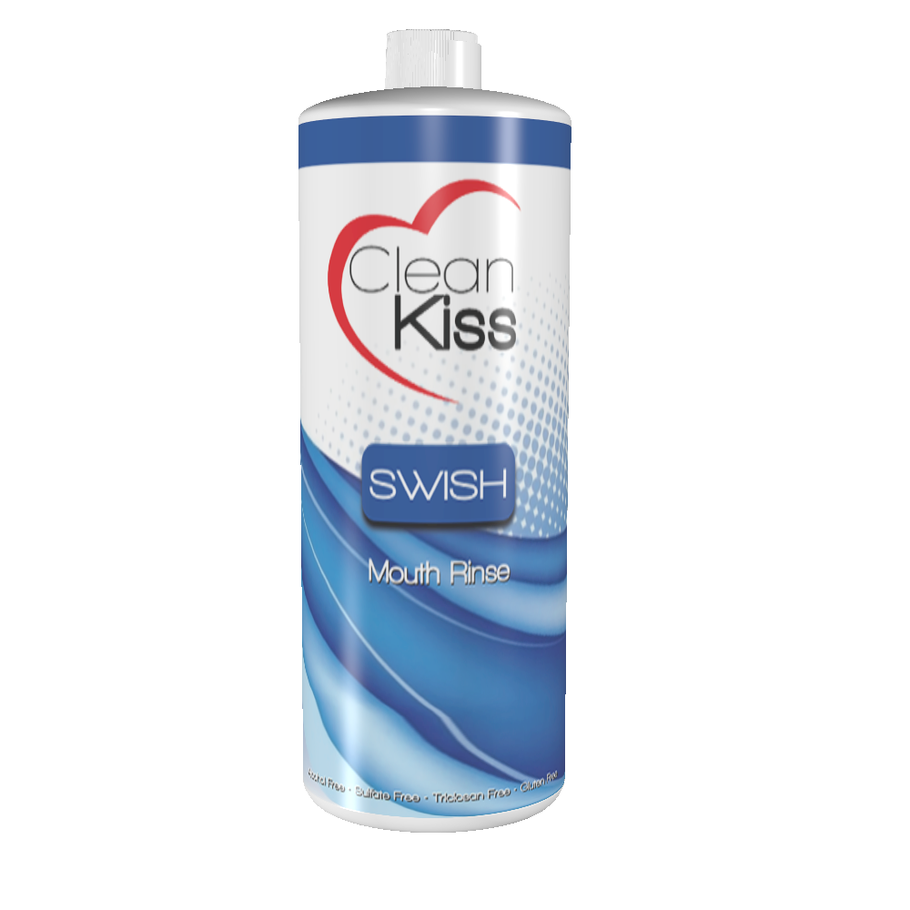
Swish
3
GARGLE FULL STRENGTH
Reaches bacteria in the back of the mouth
Use a tongue scraper for extra effectiveness
ADD to Oral Irrigator to get under gums
Swish before brushing to best kill bacteria

Slide 9
Swish
 | Kills/ removes bad bacteria | Soothes/ heals gums | Prevent Decay | Whitens Teeth | Healthy Side Effects
Xylitol |  |  | X
Organic Apple Cider Vinegar | X |  | X | X | Heart Blood Pressure A1c
Organic Peppermint Oil | X | X
Olive Leaf Extract | X | X
Tea Tree Oil | X
Sage | X | X
Aloe Vera Gel |  | X
Citric Acid | X |  |  | X
13 Essential oils/herbs | X | X
3

Slide 10
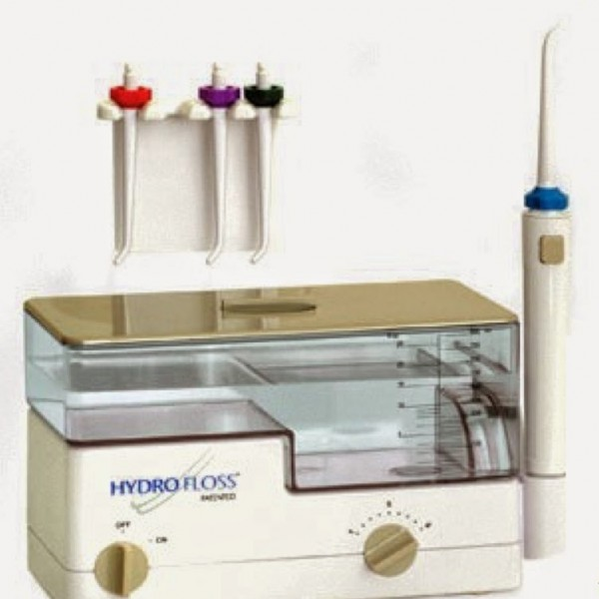
Squirt
Put four capfuls Swish Mouth Rinse plus 10 ozs water into Oral Irrigator
Reaches bacteria under gums
More effective than flossing alone, soothes tender gums
Squirt before brushing
3

Slide 11
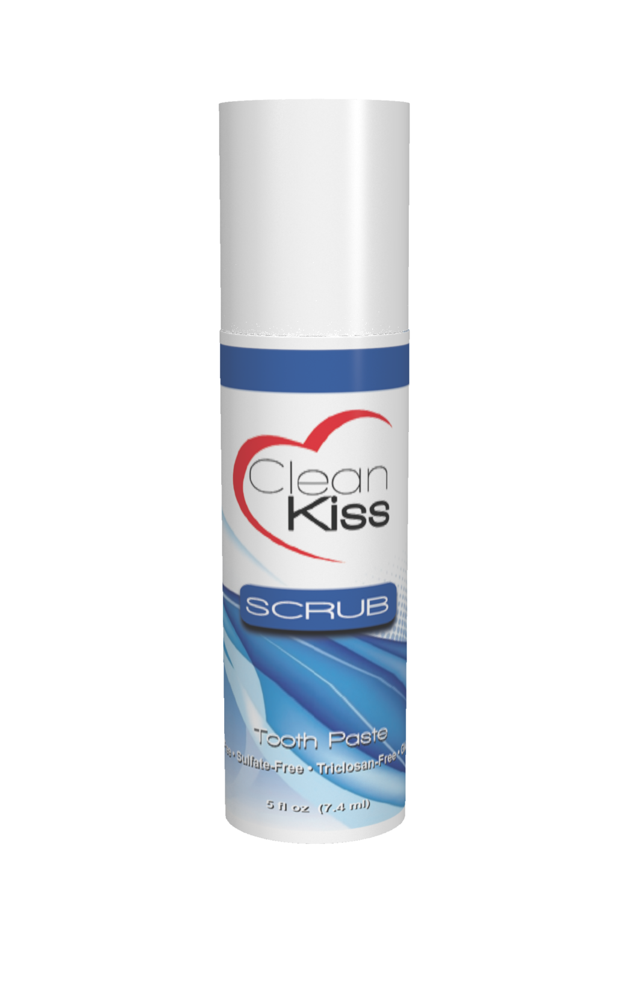
 | Kills/ removes bad bacteria | Soothes/ heals gums | Prevent Decay | Whitens Teeth | Healthy Side Effects
Sorbitol |  |  | X
Coconut Oil | X |  | X | X
Xylitol | X | X
MSM | X | X
Peppermint Oil | X
Tea Tree Oil | X | X
Rosemary Oil | X | X
Vitamin B12 |  |  | X |  | Metabolizes Sugar Helps A1c
Vitamin E Oil |  | X
Green Tea Extract | X
Aloe Vera Leaf Extract |  | X
Olive Leaf Extract
Citric Bioflavinoid | X |  |  | X
13 Essential oils/herbs | X | X
3

Slide 12
Scrub
Use electric toothbrush plus Scrub toothpaste
Gel Pump uses every last drop--NO TUBE WASTE
Scrub Gel stands upright-- easy to store and pack.
Clear pump shows you how much scrub you have left in the pump
Red/Pink color is from Vitamin B12, not artificial color
Shade of Red/Pink is due to Vitamin B12 brand available at manufacturing. Same formula
Protects enamel
Gently whitens
3

Slide 13
Oral Probiotics
Dr. Jeffry Hillman, dentist and microbiologist, was perplexed by something: “If everyone has the bacteria that cause tooth decay and gum disease in their mouths, why didn’t everyone have rampant tooth decay and gum disease?”
There had to be something, Hillman theorized, that was naturally fighting these pathogens. And that was the Eureka moment!
After isolating over 700 strains of bacteria from the mouth, Dr, Hillman found three strains that both competed with — and did not cohabitate well — with these gum and tooth pathogens. If fact they don’t even get along in petri dish!
ProBiora3 is a proprietary blend of these three naturally occurring strains of beneficial bacteria, including Streptococcus oralis KJ3®, Streptococcus uberis KJ2®, and Streptococcus rattus JH145®, which support gum and tooth health, whiter teeth and fresher breath.
For over 30 years, the oral health benefits provided by these three strains of
bacteria have been well documented in numerous peer-reviewed publications.
Today, ProBiora is the ONLY probiotic specifically designed for better tooth, gum, and mouth health.

Slide 14
Oral Probiotics

Slide 15
Oral Probiotics
Patented proprietary mix of 125 Million
Streptococcus uberis KJ2
Streptococcus oralis KJ3
Streptococcus rattus JH145

Slide 17
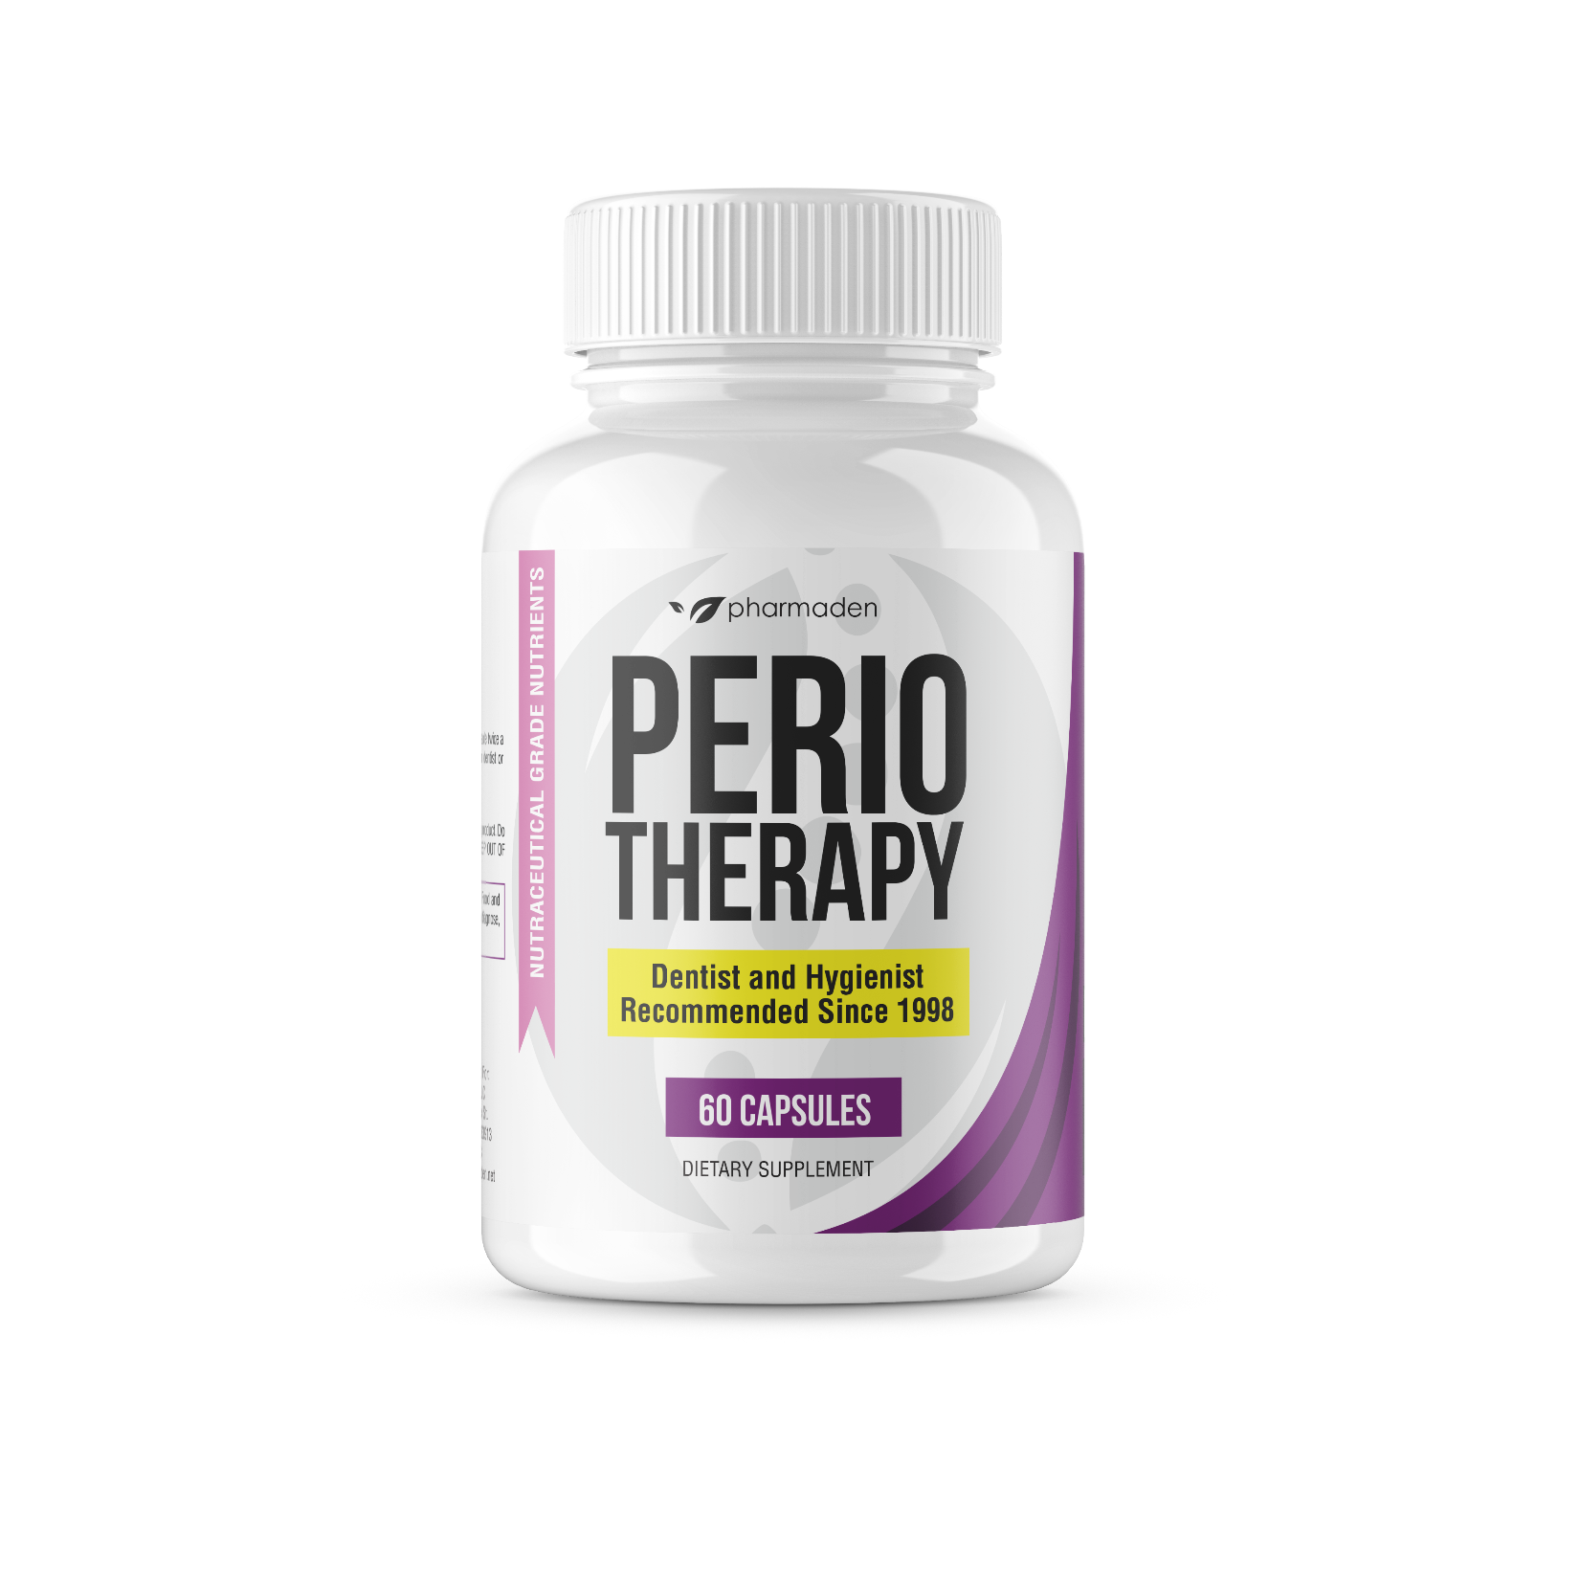
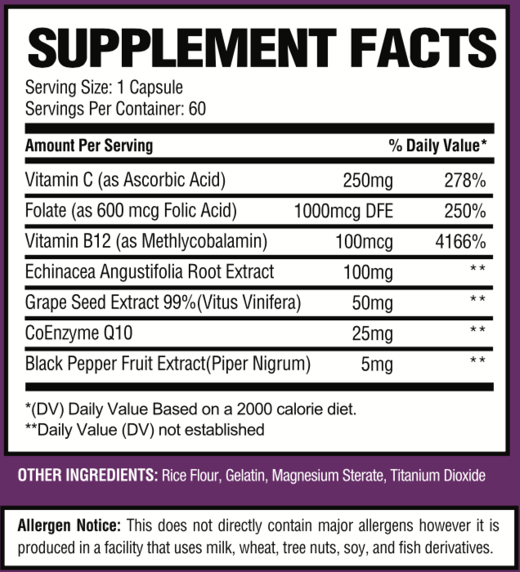
Perio Therapy
Highly absorbable nutrients for greater bone heal
Notes:
PerioTherapy’s dramatic results are achieved by synergistically balancing the correct ratio of only the highest quality ingredients. A formula’s ultimate bio-availability (the body’s ability to absorb nutrients) is determined by the proper combination and the quality of the nutrients selected. PerioTherapy, a diligent homecare program, and the personalized treatment from your dentist and hygienist are the key components to good oral health.
Benefits of Pharmaden’s PerioTherapy may include, but are not limited to:
· May reduce plaque*
· May reduce bleeding of the gums*
· May reduce pocket depth*
· May promote bone remineralization where bones can be regrown*
· May support the immune system and strengthen immune system functions*
Serving Size: 1 capsule
Suggested Use: 1 capsules twice daily with or without food or as recommended by your dentist or hygienist. Always check with your physician before taking any supplement or medicine.
PerioTherapy contains echinacea. Some studies show extended use of echinacea may weaken the immune system. People with immune disorders, such as multiple sclerosis, lupus, HIV and rheumatoid arthritis should not take echinacea supplements. If you are recommended to take PerioTherapy but unable to because of echinacea, ask your physician about PerioCare.
*These statements have not been evaluated by the Food and Drug Administration. This product is not intended to diagnose, treat, cure, or prevent any disease. Always check with your physician before taking any supplements

Slide 18
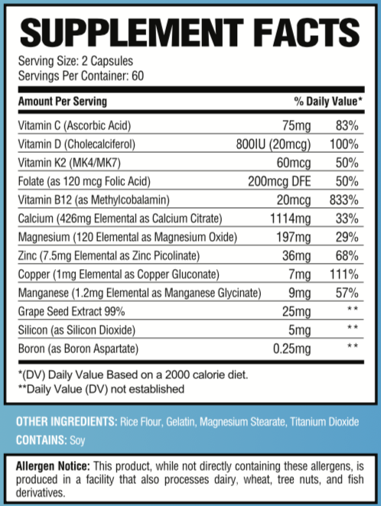
Bone Support
Notes:
Highly absorbable nutrients for greater bone health1,114 mg of calcium per serving in the form of calcium citrate to help support bone health*800 IU of vitamin D3 per serving to help your body absorb calcium*197 mg Magnesium and essential bone supporting minerals: zinc, copper and manganese*Gentle on your digestive systemCan be taken with or without foodFor men and womenSee the benefits of each ingredient here: www.pharmaden.net/bone-supportContains 60mcg vitamin K2 (MK4/MK7):- MK4 – Recent studies show taking vitamin D, calcium, and magnesium supplements did not have a significant decrease in bone fractures and, instead, taking MK4 with calcium and vitamin D does significantly lowers bone fractures. MK4 stopped and reversed bone loss, grew stronger bones, and reduced fractures more than 80%.– MK7 – Shown to reduce fractures and maintain bone density. K2-7 safely directs calcium to your bones instead of your arteries (so arteries do not harden).Serving Size: 2 capsules once or twice daily with or without food or as recommended by your doctor, pharmacist, or healthcare professional. Always check with your physician before taking any supplement or medicine.

Slide 19
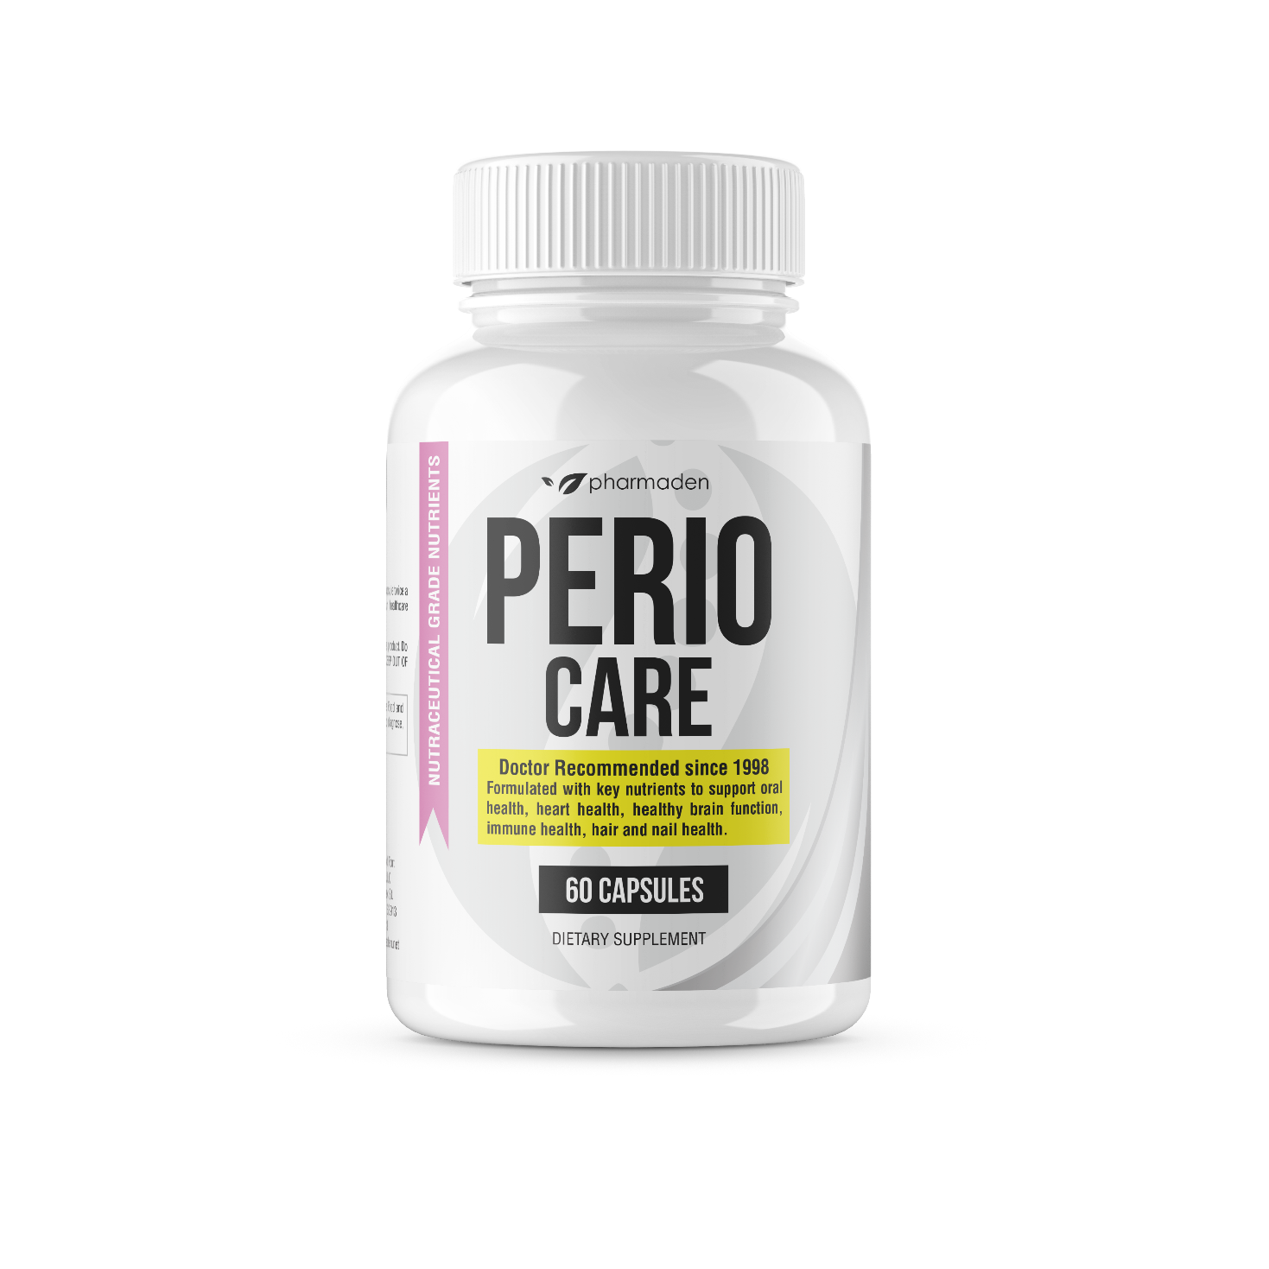
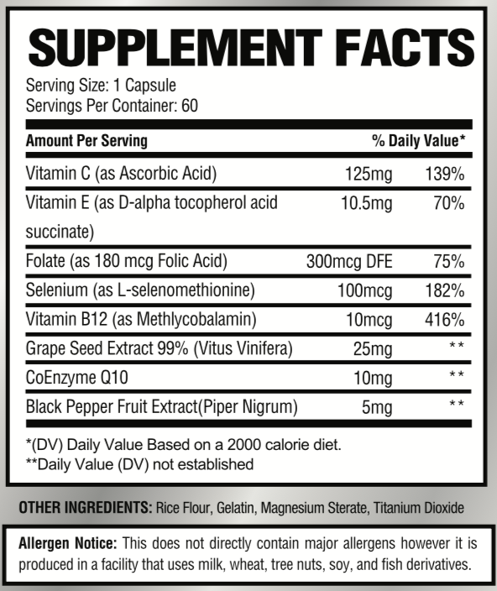
Post Perio Therapy Support
Notes:
Systemic Support: PerioCare Maintenance & Prevention is specifically designed as the perfect complement following PerioTherapy, to help maintain the results of the Dentist’s Treatment. Pharmaden’s PerioCare special proprietary formulation developed to help maintain and enhance the body’s host resistance.
Optional: Continue OsteoTherapy+ as an ongoing support program for bone re-mineralization. Calcium supplementation may also reduce the risk of osteoporosis.
Serving Size: 1 capsule
Suggested Use: 1 capsules twice daily with or without food or as recommended b your dentist or hygienist. Always check with your physician before taking any supplement or medicine.
1
ADD TO CART
SKU: 3 Category: Pharmaden Products
Description Additional information

Slide 20
Ingredient Benefits
ALL NATURAL
No chemicals, alcohol, preservatives, fluoride, artificial anything
Won’t stain or sting
Cleans without abrasives
INGREDIENTS KILL BACTERIA/FIGHTS INFECTION
Proprietary blend of Essential Oils and Herbs
Tea Tree Oil, Clove Oil, Peppermint Oil, Rosemary Oil, Coconut Oil
Apple Cider Vinegar
WHITENS TEETH
Coconut Oil, Sodium Bicarbonate, Peppermint Oil, Apple Cider Vinegar
SUPPORTS HEALING
Green Tea Extract, Aloe Vera Leaf Extract, Olive Leaf Extract
PREVENTS CAVITIES
Vitamin B12, Zylitol, Trace Minerals
TASTES GOOD
Freshens mouth without stinging
LONG LASTING FRESH MOUTH
Oils lightly coat teeth between brushings
3

Slide 21
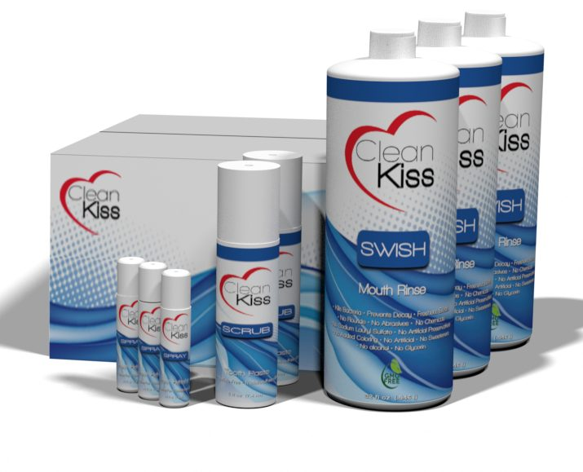
Autoship
3 month kits saves you time and money!
Set it and Forget it…FREE Shipping…Easy to stop…No Inventory
50 patients on 3 month autoship gives you min $120,000 revenue per year with no added Chair time

Slide 22
Get Started with 5 Complete Clean Kiss 3 month Kits
Includes:
15 32 OZ Swish Mouthwash
10 4 OZ Scrub Toothpaste
5 90 Day Oral Probiotics
15 Perio Therapy Nutriceutical
15 Osteo+ Bone Support Nutriceutical
Website Affiliate Link Button
$1,249.75 Retail
$ 999.75 Distributor Pricing
$ 250.00 Revenue per Complete Kit

Slide 23
We’re not worried….Our System is THAT Good
PLUS…. We’re putting our money where your patient’s mouth is!
Notes:
We’re putting our money where YOUR mouth is with our Empty Bottle Money Back Guarantee. Use our 3 month Complete Kit, then take your empty bottles to your hygienist or dentist to compare your gum health before and after using The Clean Kiss Solution. If your gums are not healthier*, we will refund your money (except shipping). Send your name and your dentist’s name to info@cleankiss.com so we can verify your claim. We’re not worried. Clean Kiss is THAT good! * Healthier means either bleeding or tissue damage (pocketing) has improved since your last periodontal charting done within 6 months before using Clean Kiss. The 3 month Complete kit includes: Complete 90 day supply of all the Clean Kiss Oral Care System, including Perio Therapy, Osteo+ Nutraceuticals and Oral Probiotics to Scrub toothpaste and Swish Mouthwash. A kiss of health with your clean kiss!

